Slide 1

Introduction

Slide 2
Objectives
Link GitHub to Watson Studio
Understand how to connect Watson Studio account with GitHub
Publish Watson Notebook on GitHub.
Add Notebook to Watson.
Import a Jupyter notebook in a Watson Studio Project
Perform the tasks in the Jupyter notebook
Data Science Capstone

Slide 3
Link GitHub to Watson Studio
Create a GitHub account
Add a Project / Repo
Edit / Create a file
Upload a file & Commit
➔ Do by yourself
Data Science Capstone

Slide 4
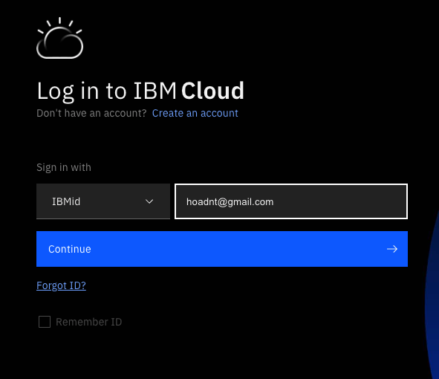
Integrate Watson Studio with GitHub
Login to IBM Cloud account: https://cloud.ibm.com/login
Open Resource Summary using https://cloud.ibm.com/resources
Data Science Capstone

Slide 5
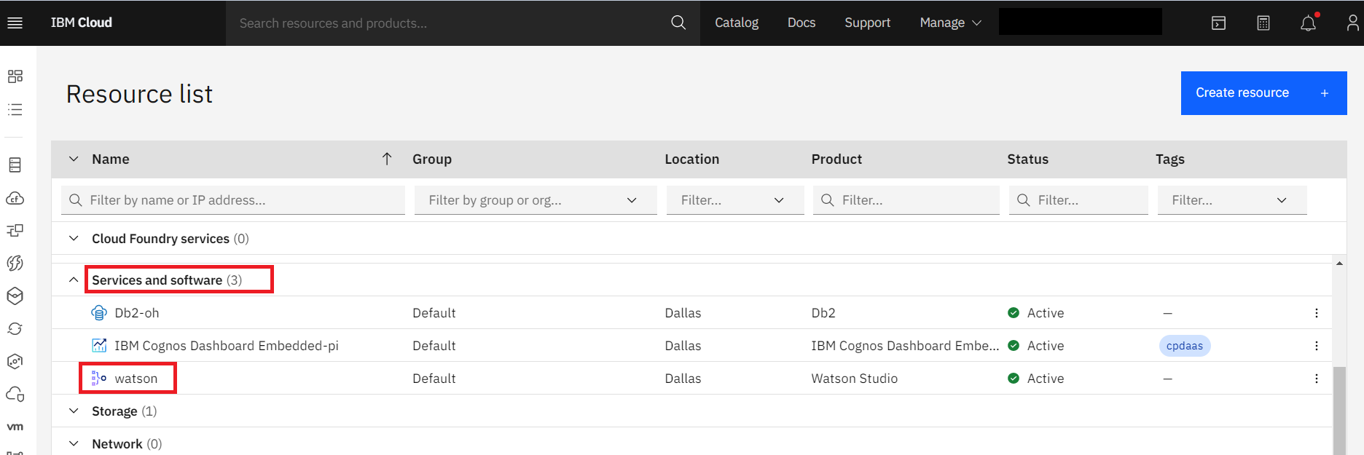
Integrate Watson Studio with GitHub
Click Service and Software. Click Watson Studio.
Data Science Capstone

Slide 6
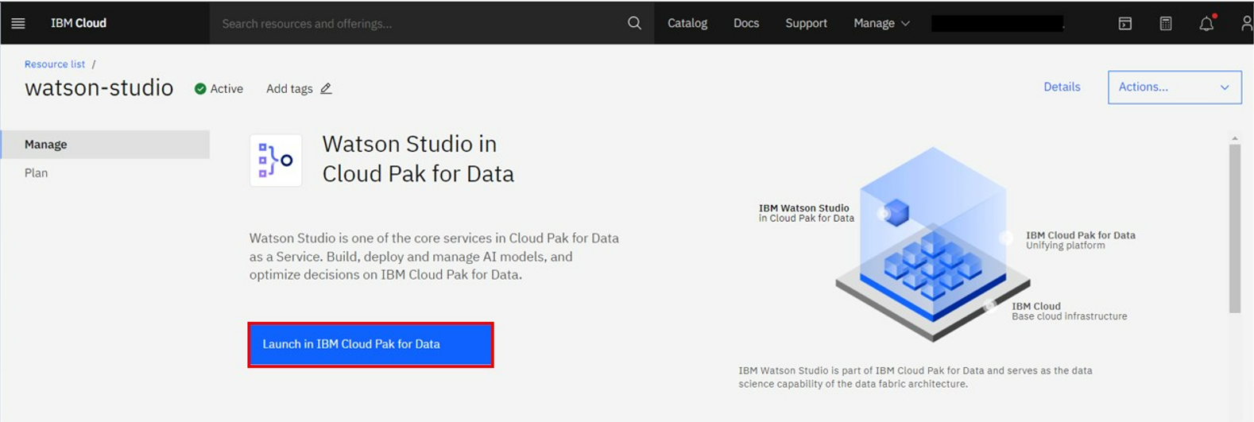
Integrate Watson Studio with GitHub
You will be redirected to Watson studio. Click Launch in IBM Cloud Pak for Data.
Data Science Capstone

Slide 7
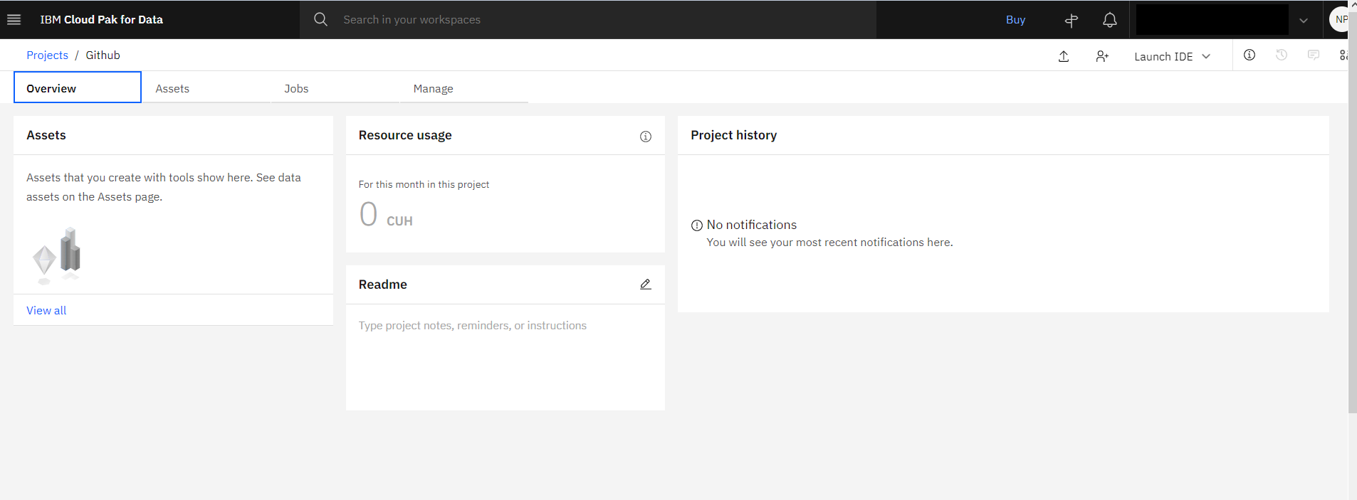
Integrate Watson Studio with GitHub
Click on the project you have created already.
Once you open the project, the page looks like as:
Data Science Capstone

Slide 8
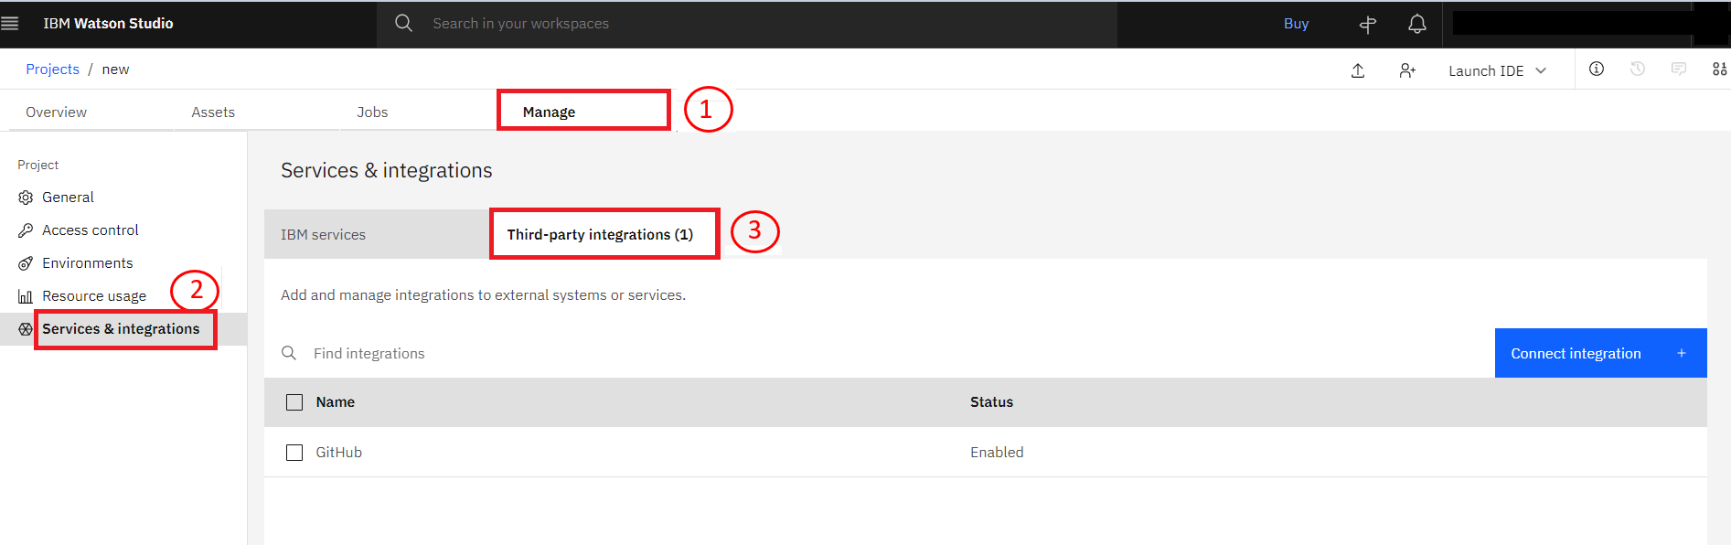
Integrate Watson Studio with GitHub
Click on Manage tab. Select Service & integrations and click Third-Party integrations.
Data Science Capstone

Slide 9
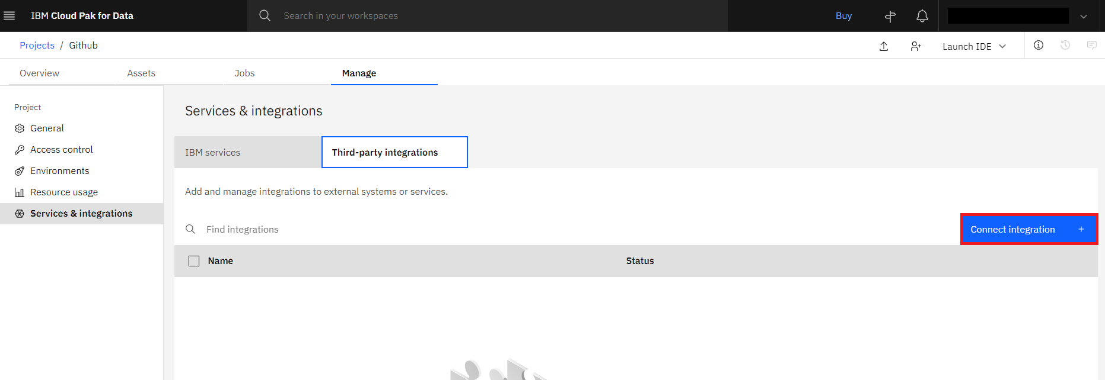
Integrate Watson Studio with GitHub
Click on Connect integration
Data Science Capstone

Slide 10
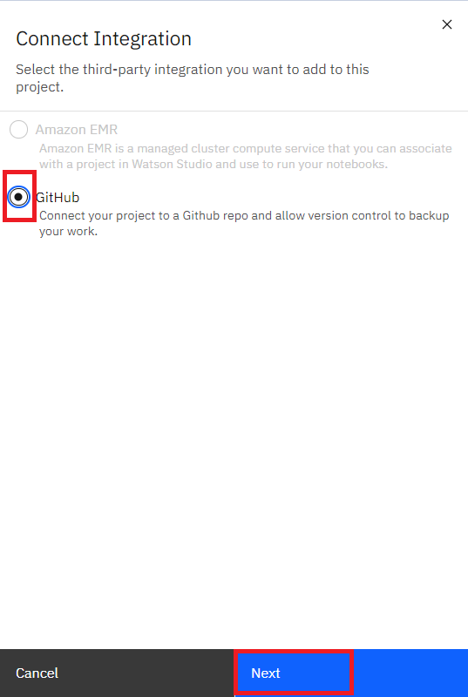
Integrate Watson Studio with GitHub
Select GitHub and click Next.
Data Science Capstone

Slide 11
Integrate Watson Studio with GitHub
Then generate Access Token and add it in Personal access Token. Once the Access token is added, enter the repository name where you want to push the notebook. Then click on connect button.
Once the repository is added successfully, you get a successfully connected message as shown in the screenshot below:
Data Science Capstone

Slide 12
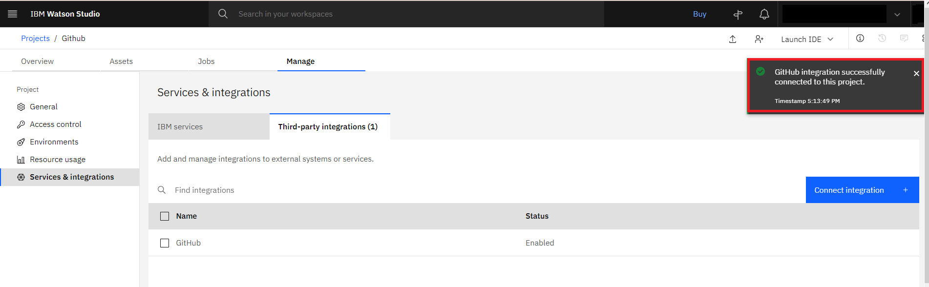
Integrate Watson Studio with GitHub
Data Science Capstone

Slide 13
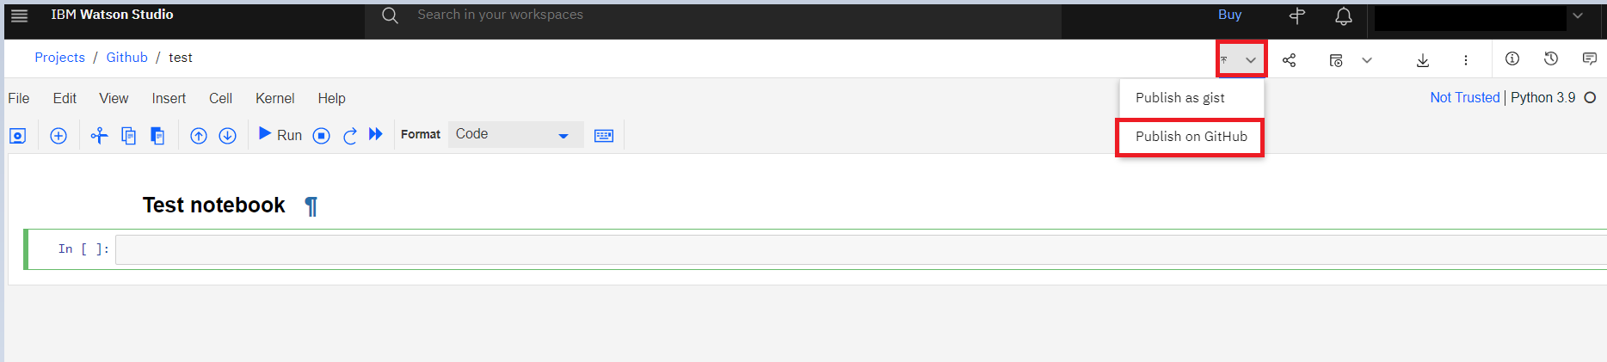
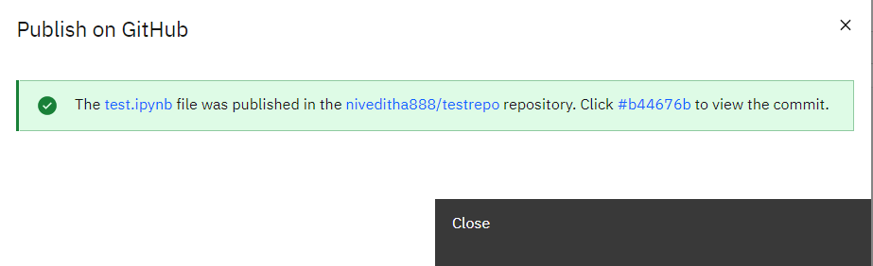
Publish Watson Notebook on GitHub
Select the notebook you wish to push on to the GitHub, select the up-arrow and click on Publish on GitHub.
Data Science Capstone

Slide 14
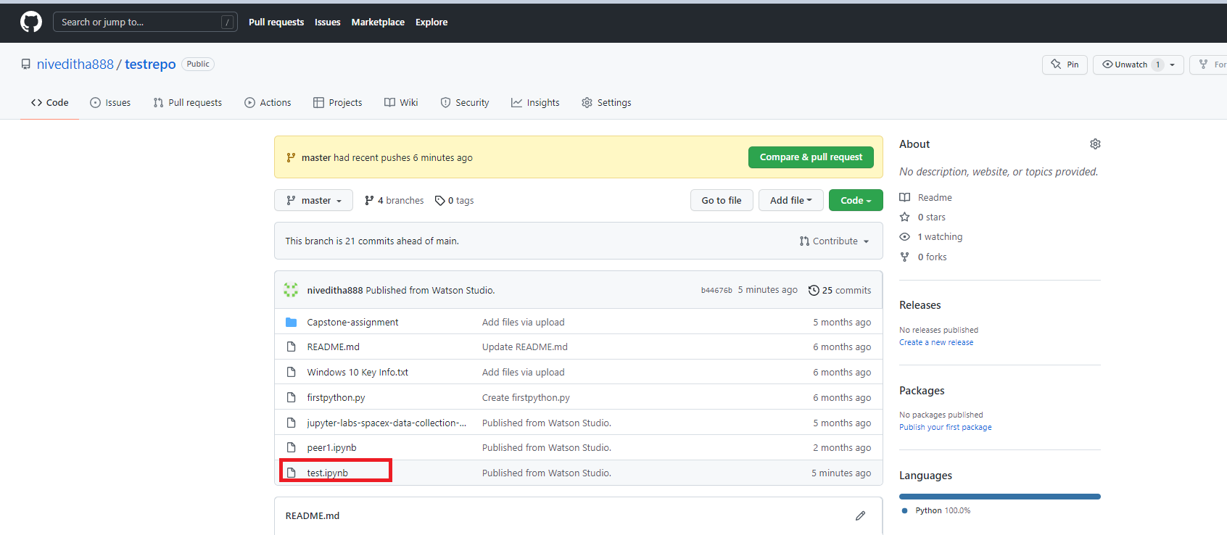
Publish Watson Notebook on GitHub
You can see the notebook test.ipynb which you have published from Watson Studio.
Data Science Capstone

Slide 15
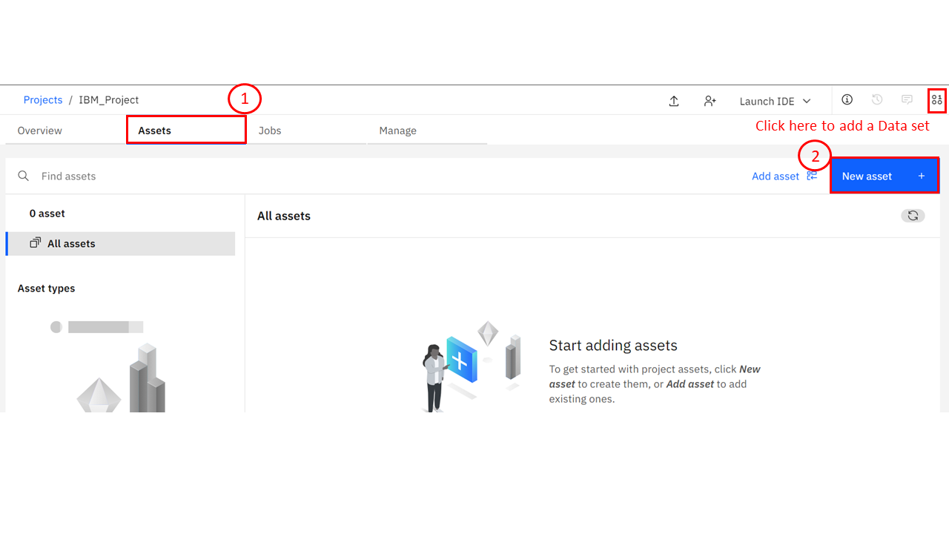
Add a Notebook to the Project
Adding a Notebook to the Project:
  You need to add a Notebook to your project. Click on Assets > New asset.
Data Science Capstone

Slide 16
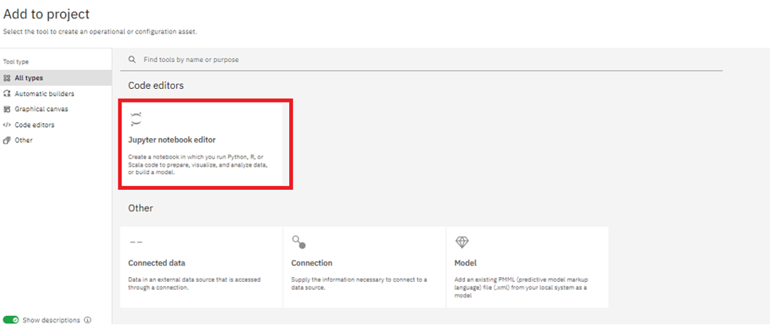
Publish Watson Notebook on GitHub
Scroll down and select Jupyter Notebook Editor:
Data Science Capstone

Slide 17
Publish Watson Notebook on GitHub
On the New Notebook page, enter a name for the notebook, and then click From URL.
Paste the URL you copied from the previous reading in the course into the Notebook URL box, and then click Create.
Right-click the following link, and copy its URL then import it to Watson Studio:
Data Science Capstone

Slide 18
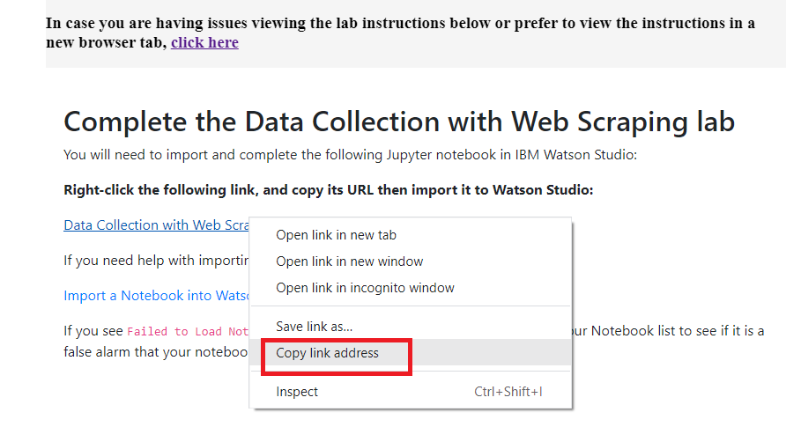
Publish Watson Notebook on GitHub
Data Science Capstone

Slide 19
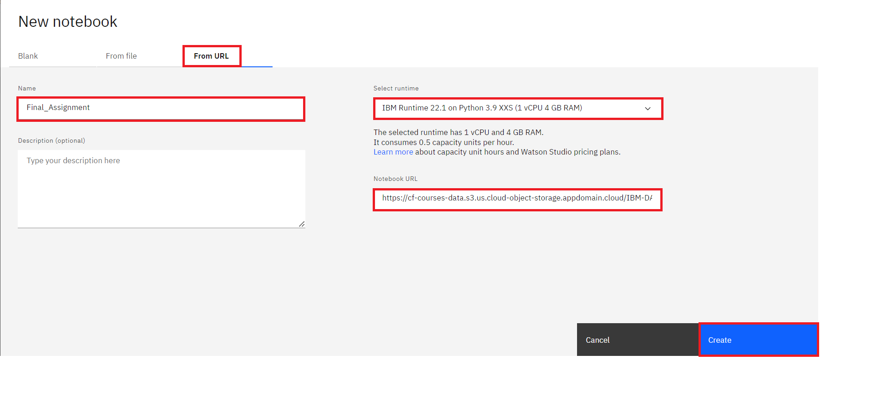
Publish Watson Notebook on GitHub
Data Science Capstone

Slide 20
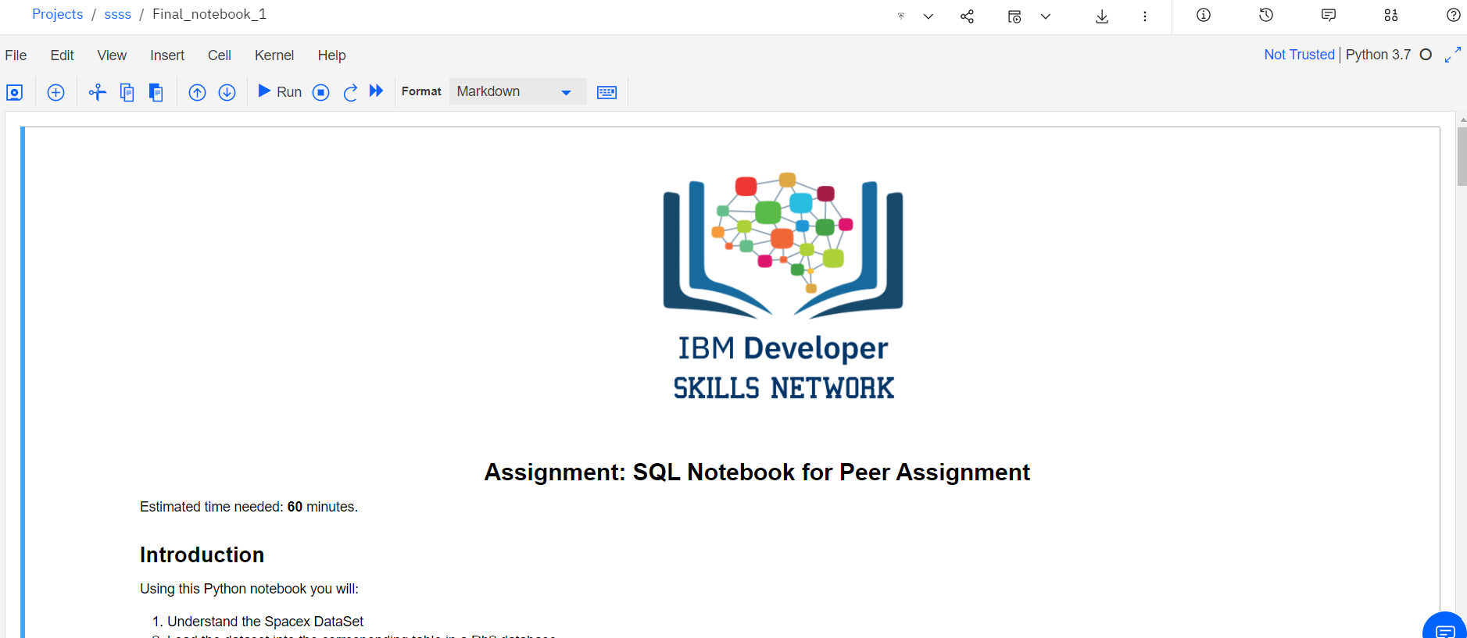
Publish Watson Notebook on GitHub
You will see a Notebook like this (the actual notebook may be different from the one shown in the screenshot below):
Data Science Capstone

Slide 21
Summary
Linking GitHub to Watson Studio
Understand how to connect Watson Studio account with GitHub
Publish Watson Notebook on GitHub.
Adding Notebook to Watson.
Import a Jupyter notebook in a Watson Studio Project
Perform the tasks in the Jupyter notebook.
Data Science Capstone

Slide 22
Q & A
Data Science Capstone

